Slide 1
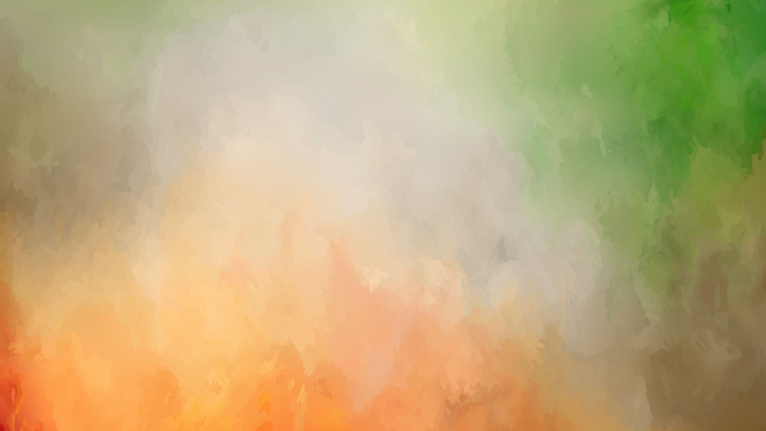
Genetic Mutations
Unit 4: Human Variation and Evolution

Slide 2
Learning Objectives
Explain how different phenotypes and genotypes can affect rate of survival
Explain how mutations introduce new alleles that affect rate of survival
Mutations result from errors in DNA replication, cell division or from damage caused by mutagens

Slide 3
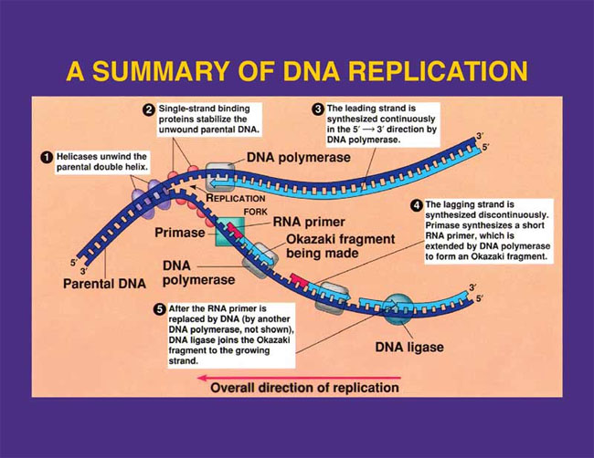
Quick Recap: Year 10 and 11.

Slide 4
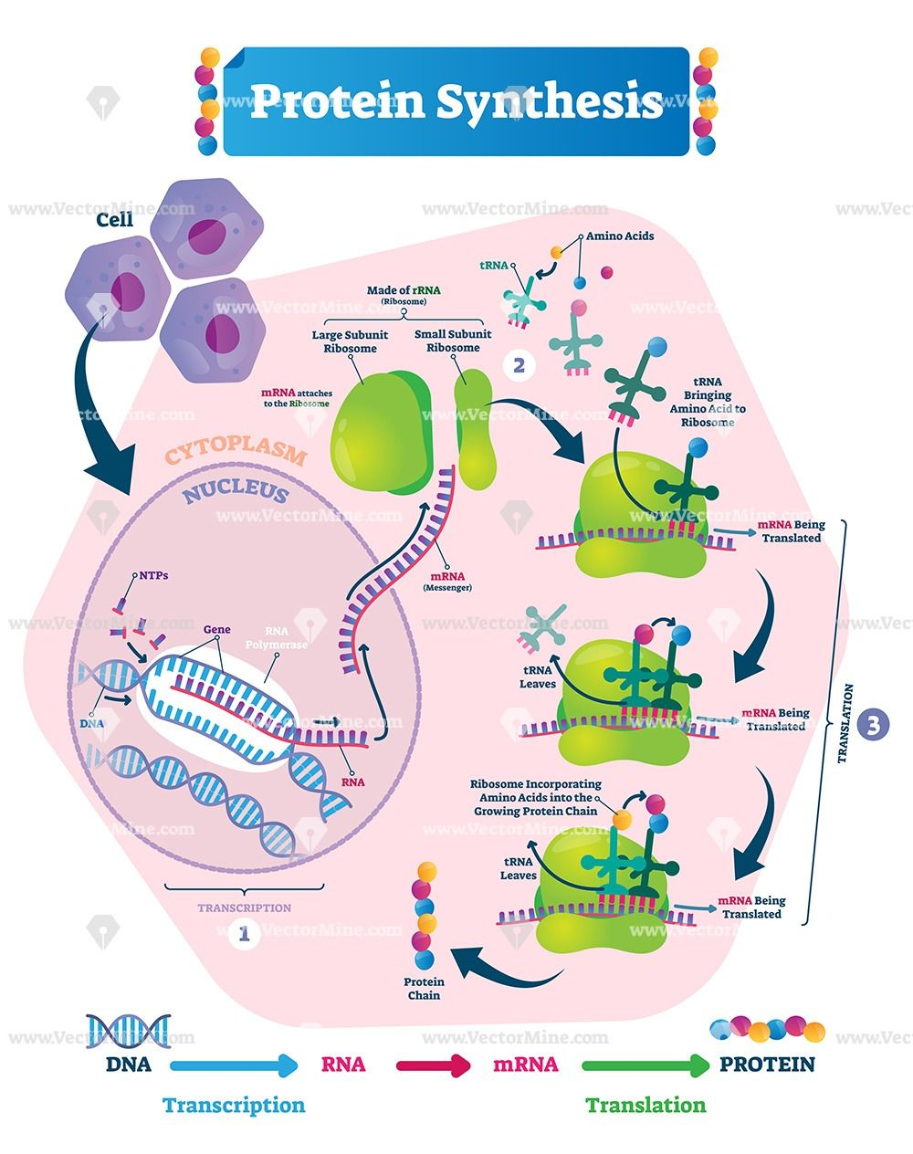
Protein Synthesis Recap:

Slide 5
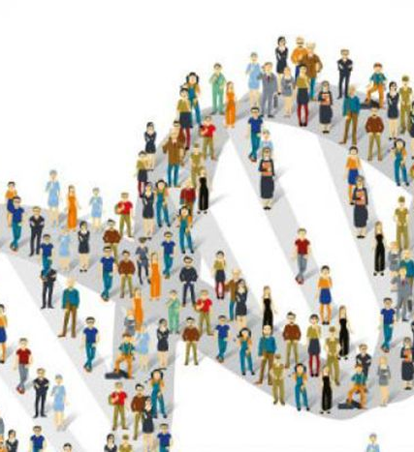
Gene Pools: What are they?
The gene pool is the sum of all alleles living in a population.
In studying the gene pool; how often each allele occurs in the gene pool is noted- this is referred to as Allele Frequencies for a population.
E.g., the allele frequency of Cystic fibrosis on Chromosome 7 is 5%, meaning for every 100 people, 95% will get a normal allele for Chromosome 7.

Slide 6

Gene Pools: Cont.….
Populations that differ in characteristics they possess are likely to have different frequencies of the various alleles of a gene in their gene pools. Hence why it is more common for some populations to have certain phenotypic traits.
Changes in Gene Pools can happen over time- this can be due to chance mutation or environmental stimuli resulting in variations of allele frequency.

Slide 7
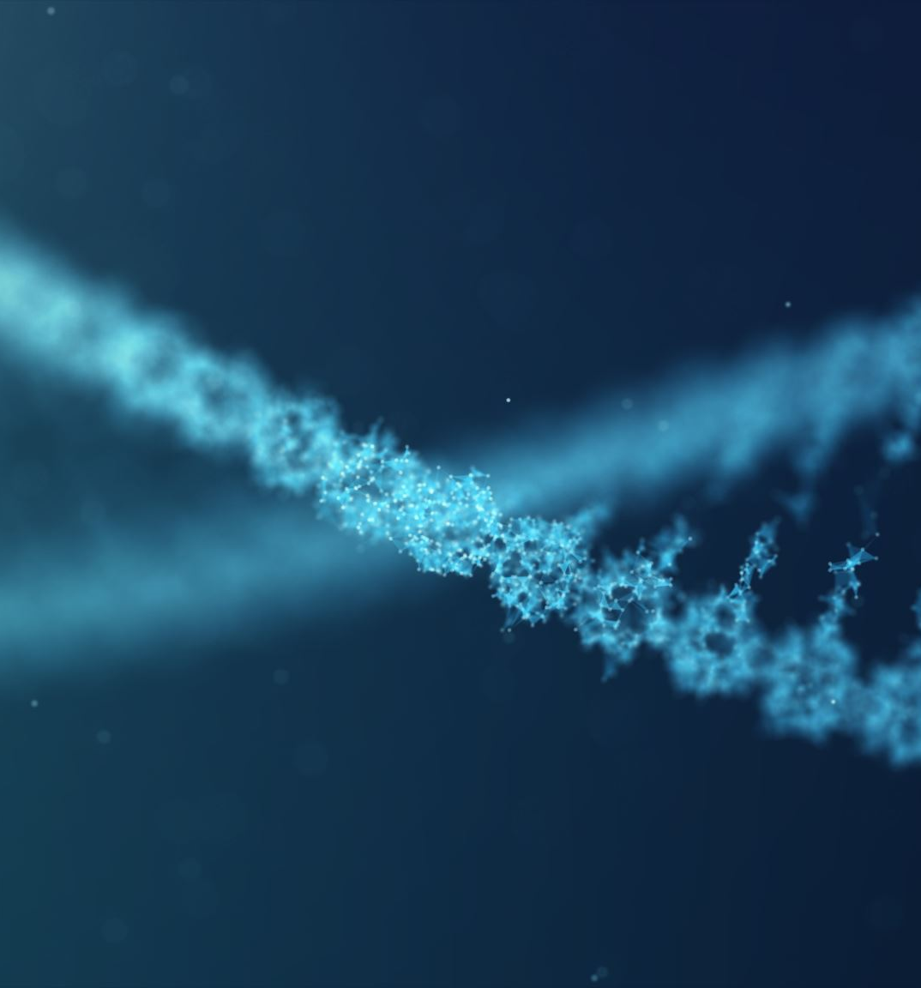
Mutations
Offspring may show changes that don’t resemble anyone in their family tree, that have occurred quite randomly and by chance. These are mutations in action!
Not all mutations are harmful and an organism with a characteristic caused by mutation is referred to as a mutant. These occur in two main ways: Gene Mutation and Chromosomal Mutation.

Slide 8
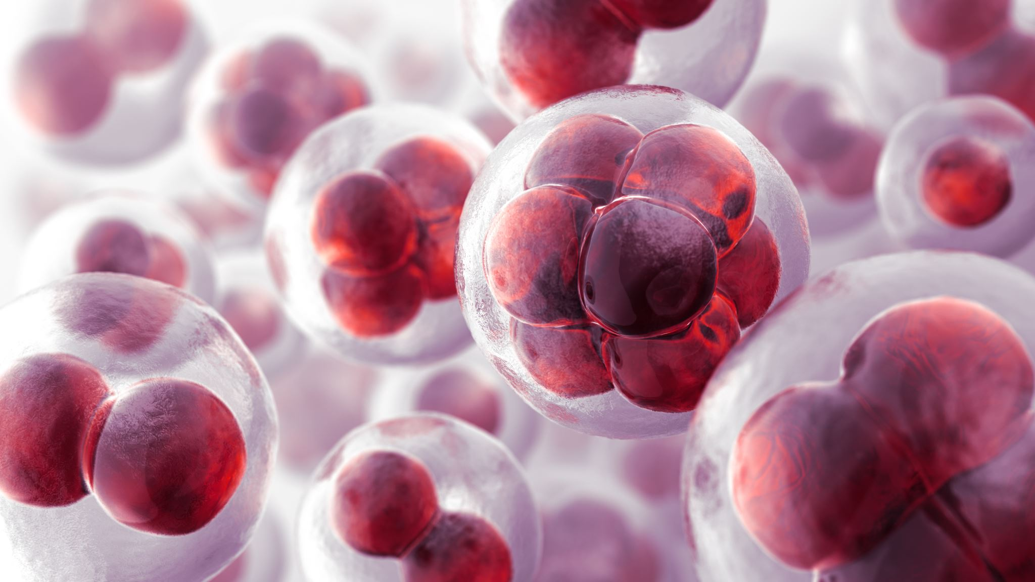
Mutations: Cont.….
Mutations can occur during DNA replication before cell division- due DNA being a complex molecule any change in the structure can change the outcome of the protein and/or characteristic of the species.
Due to cell division in mitosis and meiosis- if a mutation has occurred the cell will continue to divide and replicate this mutation and can result in it being passed down for generations.
Considering the size of the human population though- Mutations are still uncommon, and those that do occur sometimes result in traits allowing for better survival in the environmental conditions the organism is in.

Slide 9
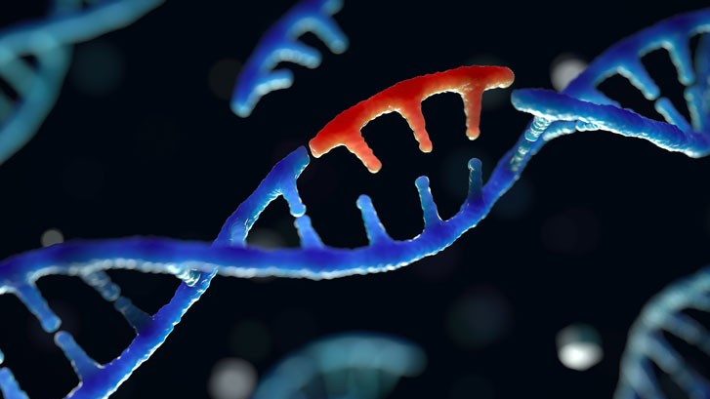
Mutagens:
Mutations occur without any known cause- however mutagens have been known to increase their rate of occurrence.
There are three types of mutagens:
Chemicals: These can insert into DNA bases or between bases causing issues with DNA replication. This includes mustard gas, formaldehyde, sulfur dioxide and some antibiotics.

Slide 10
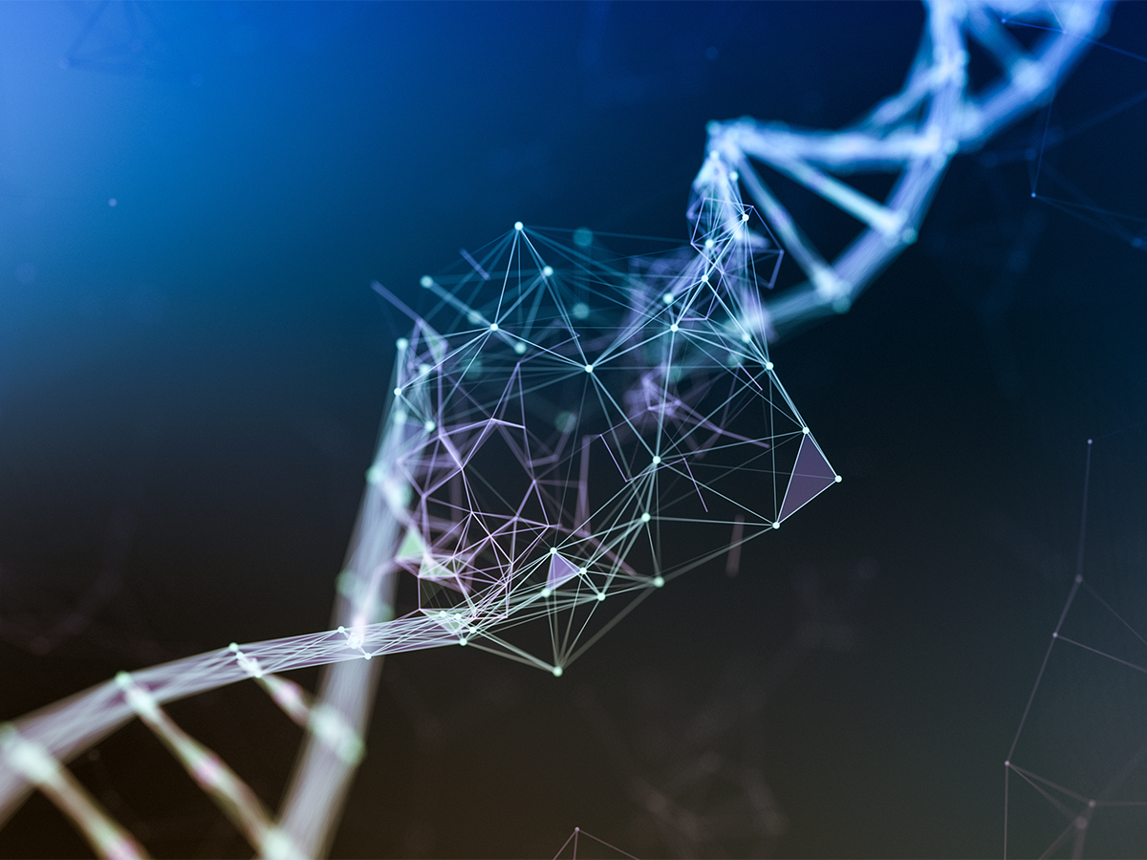
Mutagens: Cont.…
Radiation: Ionizes biochemical compounds in cells forming free radicals. The free radicals cause damage to DNA and proteins, this includes; X-rays, cosmic rays and radioactive waste
UV Light: Causes thymines that are close together on the chain to bind together causing thymine dimers, causing issues during DNA replication.

Slide 11
Somatic Versus Germline Mutations
Somatic Mutations or bodily mutations:
-Only the individual with the somatic cells can be affected.
-The Mutations is based in every mitotic division, but not in meiotic divisions.
-Very commonly involved with cancerous growth due to mutagenic agents.

Slide 12
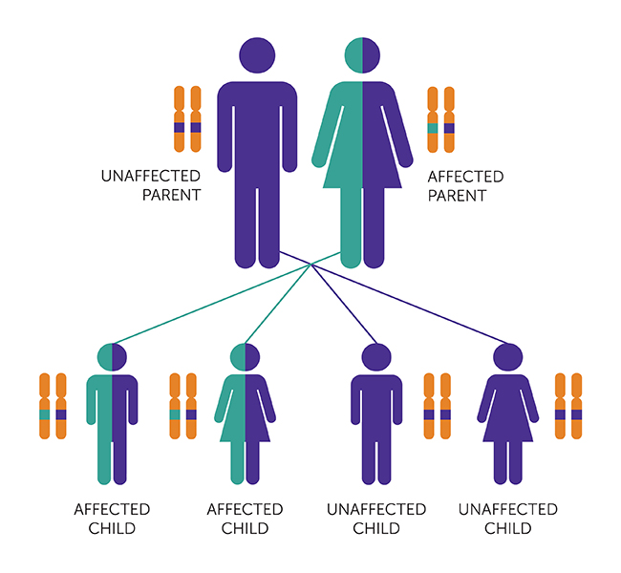
Germline Mutations or reproductive mutations:
-The person whose gametes mutated is not usually affected.
-If these mutated gametes form a zygote, then the pregnancy is often aborted naturally by the body in the early stages.
-If the child survives to birth, it can lead to harmful genetic diseases, beneficial adaptations or almost no effect at all.

Slide 13
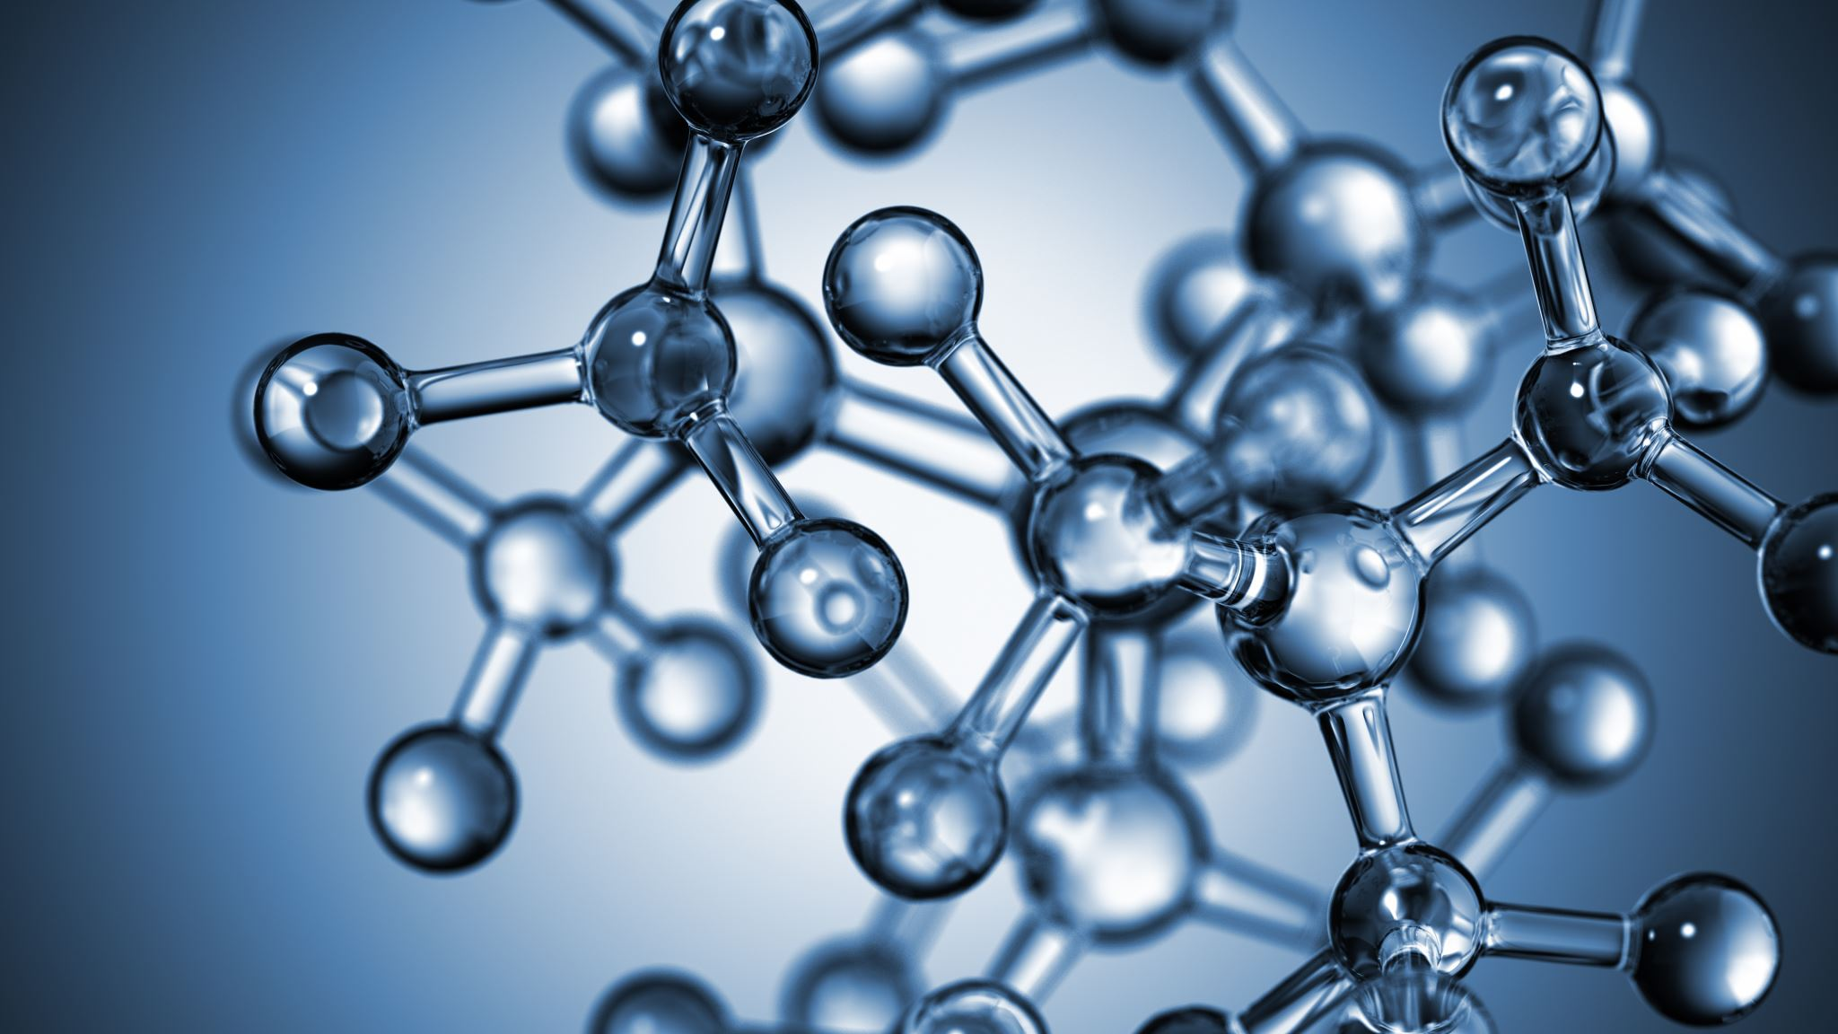
Effects of Mutations: Gene Mutations
Each DNA molecule is made up for 1 of 4 Nitrogenous bases and a sugar-phosphate backbone.
Triplets from these bases are used to code for amino acids, which are used to build a protein.
The change of one base in these sequences can cause a point mutation- which in turn can alter the amino acids and thus alter the created protein.
This can result in a missing protein or an abnormal protein, in which can have major effects on the body.

Slide 14
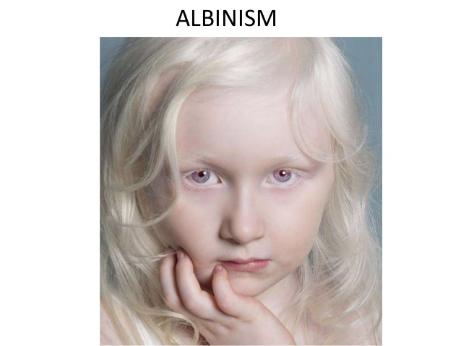
Example: Albinism is the absence of pigment in Skin, hair and eye colour.
Example: Duchene Muscular dystrophy inherited by sons from their mothers, results in the wasting away of muscles in the legs, shoulders, arms and chest. Death eventually occurs due to respiratory muscles failing.
Example: Cystic fibrosis: is recessive meaning it needs inheriting from both parents. Is when the correct protein that regulates the passage of chloride ions across the cell membrane is not created. Resulting in life-long respiratory and digestive issues.

Slide 15
Lethal Recessives:
Most gene mutations produce a recessive allele, meaning you could have many mutations and be completely unaware of them. This is because the recessive can prevent the gene from producing proteins.
If two partners reproduced, and both had the recessive mutation, this means their offspring has a chance of receiving the recessive condition.
Some recessive mutations are lethal if they are not masked by a dominant normal allele. These can result in death of an embryo or foetus or early death of a child.
Example: Tay-Sachs Disease: disorder of lipid metabolism that results in fatty acids accumulating in and overwhelming the nervous system.
These lethal recessives are slowly eradicated from the gene pool though, as the offspring do not live long enough to pass on their genes.

Slide 16
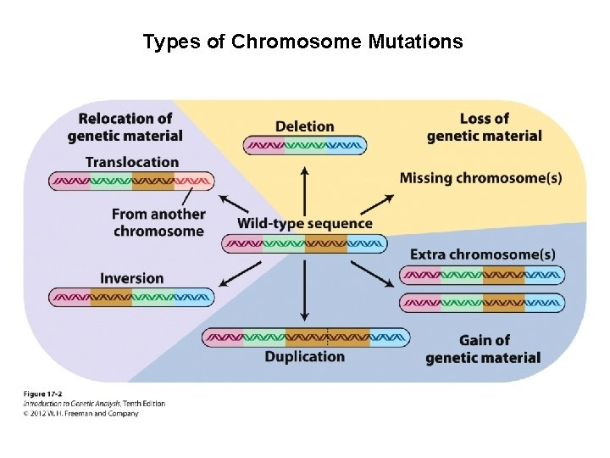
Effects of Mutations: Chromosomal Mutations

Slide 17
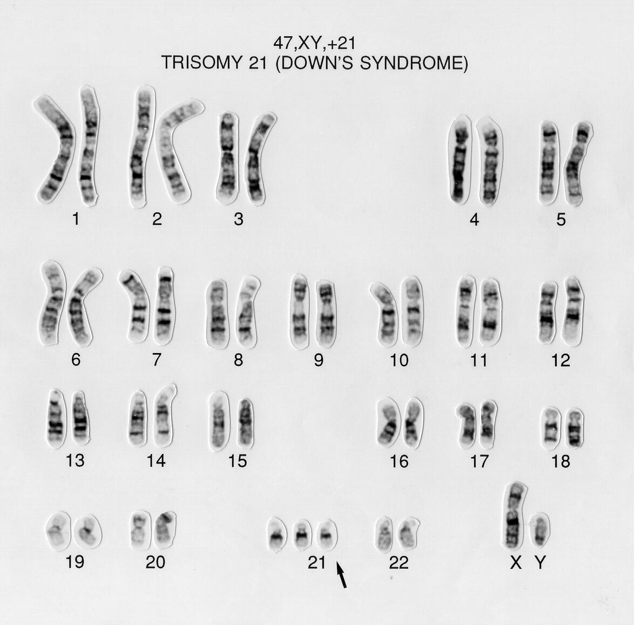
Case Study 1: Down Syndrome
Down Syndrome or Trisomy 21- Caused from a Non-Disjunction Chromosomal Mutation
Is when a child has 3 alleles of Chromosome 21 instead of a normal two.
Many symptoms of down syndrome can still occur when part of an extra chromosome is still attached to another- this is called Partial Trisomy.

Slide 18
Case Study 2 & 3: Patau Syndrome and Klinefelter’s Syndrome
Patau Syndrome is when an extra Chromosome 13 produces mental retardation, an extra finger, cleft plate and malformations of the ears and eyes. This Trisomy 13 occurs in every 1 of 5000 live births, however 80% of the children generally die within a month.
Klinefelter’s Syndrome is affected in the sex chromosomes in males. This can cause an extra X or Y chromosome. The XXY mutations are normal as boys will develop Klinefelter’s as adults. These males do not produce sperm, have enlarged breast, sparse body hair and occasionally have mental retardation.

Slide 19
Case Study 4 & 5: Cri-du-Chat Syndrome and Turner’s Syndrome
Cri-du-Chat Syndrome is an example of monosomy, when the child is missing part of chromosome 5. This rare disorder gets it characteristic cry (sounding like a meowing kitten) which is due to problems with the larynx and nervous system.
Turner’s Syndrome: is an example of monosomy affecting sex chromosomes. Individuals are born with only one X chromosome. These females are short in stature, lack secondary sexual characteristics and are infertile. This condition can be tested before the child is born, by testing amniotic fluid. Parents are then given the decision to terminate or go through with the pregnancy.

Slide 20
Did we meet our objectives?
Can we explain how different phenotypes and genotypes can affect the rate of survival?
Can we explain how mutations introduce new alleles that affect rate of survival?
Can we explain how mutations result from errors in DNA replication, cell division or from damage caused by mutagens?

